Slide 1
Deep
Learning
Minor
Youssef Ennali

Slide 2

Basics of Machine Learning
Book discussion
Supervised vs unsupervised learning
Machine learning process
The goal of machine learning
Underfitting
Overfitting
Classification
Regression
Questions?

Slide 3
Book discussion
What did you learn from the book so far?
Pass the question to your fellow student…

Slide 4
Supervised vs unsupervised learning
Supervised: It is defined by its use of labeled datasets to train algorithms that to classify data or predict outcomes accurately (Source: IBM)
Unsupervised: the use of artificial intelligence (AI) algorithms to identify patterns in data sets containing data points that are neither classified nor labeled. ... In other words, unsupervised learning allows the system to identify patterns within data sets on its own. (Source: Techtarget)

Slide 5


1. Collect data
2. Prepare data
3. Split data
Train & Test
Set
Data Set
Data Set
4. Train or Optimize model
5. Validate Model
No
[Acceptable accuracy]
Yes

Slide 6
1. Collect data
Determine the problem to be solved
Explore and collect data sources relevant for this problem

Slide 7
2. Prepare data (more on this in chapter 6)
Transform, cleanse, combine etc.

Slide 8
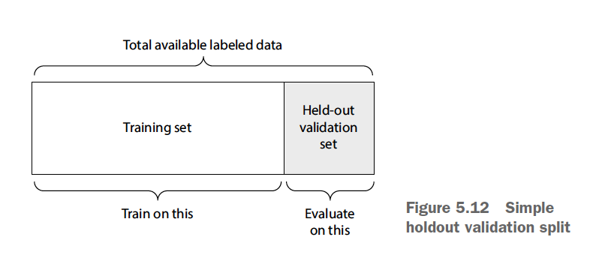
3. Split data
Determine ratio for train and test data set
Split the data into a train and test set

Slide 9
4. Train model
Determine ratio for train and test data set
Choose a suitable algorithm for data set and problem
Train the model
4. Optimize model (when accuracy not acceptable)
Update weights
Retrain model
Rmsprop optimizer used in the book, however there are other methods

Slide 10
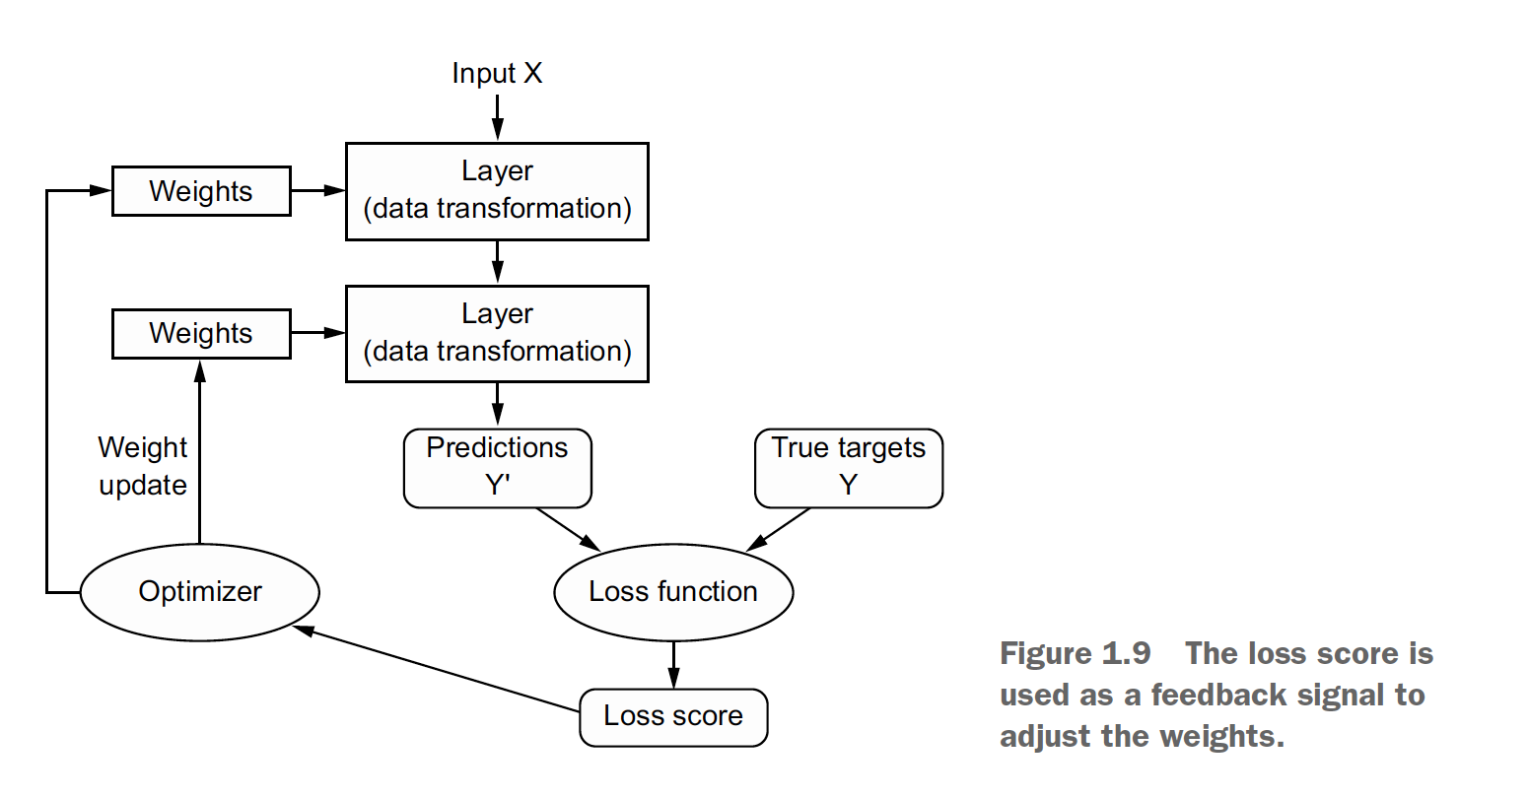
5. Validate model (also known as model evaluation)
Generate output
Prediction
True target
Determine accuracy
Loss function
Loss score

Slide 11
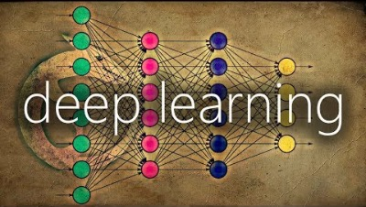
Loss function shortly explained

Slide 12
Some loss function examples:
Mean squared error
Likelihood loss
Log loss (cross entropy loss)
…
More on this: link

Slide 13
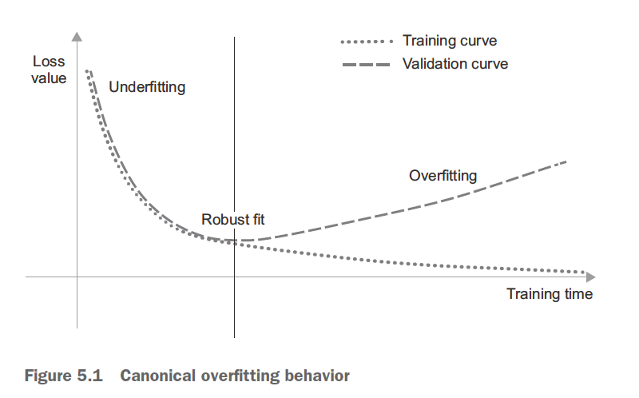
The goal of machine learning
Achieve generalization by training a model and check how well it performs on new data
Tension between optimization and generalization (model fitness)
Overfitting
Underfitting

Slide 14
Overfitting

Slide 15
Underfitting

Slide 16
Classification & regression
Most common machine learning problems
Supervised learning
Classification
Regression
Classes
Numbers
Binary classification (2 mutually exclusive classes)
Multiclass classification (more than 2 mutually exclusive classes)
Linear regression

Slide 17
Classification algorithm examples:
1. Logistic regression
2. Naive Bayes
3. K-Nearest Neighbors
4. Support Vector Machine
5. Decision Tree
Regression algorithm examples:
Linear Regression
Decision Tree
3. Support Vector Regression
4. Lasso Regression
5. Random Forest

Slide 18
Short exercise:
Binary classification, multiclass classification or regression?
Predict housing prices?
Predict whether there will be a default on a loan?
Predict survival rate of a patient?
Determine which product(s) to cross offer to a customer?

Slide 19

Questions?

